Slide 1

A Leap for Mankind
Valentina Mosquera Reina, Matt Bauer, Josiah Williams, Ryan Cunico
Notes:
Ryan
We are Leap of mankind. We have developed an entertaining car racing game utilizing ScratchX, a programming language that uses building blocks of code to make program design fun and easy. Along with ScratchX, we implemented LeapMotion, a controller device that will sense your hand motions and control the car.

Slide 2
Description of TAP Program
The Technology Ambassadors Program (TAP) is an interactive class focused on service learning.
TAP provides the opportunity to build a project using different technologies and collectively deliver it through conferences, student involvement, workshops, and outreach events.
Notes:
ryan

Slide 3
Please take the pre-survey!
https://ggc.az1.qualtrics.com/jfe/form/SV_dgR1LQyvXpy3Rc1
Notes:
ryan

Slide 4
Description of If / While Loops
“If” statement -> “If” my hands are dirty, “then” I will wash them with soap and water.
“While” statement -> “While” my hands are covered in soap and water, I will continue to wash them.
Notes:
valentina - exploring

Slide 5
Concepts to Teach
Students will be exposed to the following concepts while developing their racing games.
The students will be exposed to the following using these examples:
”While” loop – corresponds to the “forever” that makes the car move forward
“If” statement – “If” car touches green, stop and change to crashed car
“If” statement – “If” car touches “V” (pink or blue boost) - speed up
“If” statement – “If” car touches finish line (white) – end and display message
Listeners for the right / left arrows (to turn the car)
Notes:
valentina

Slide 6
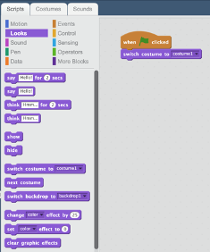
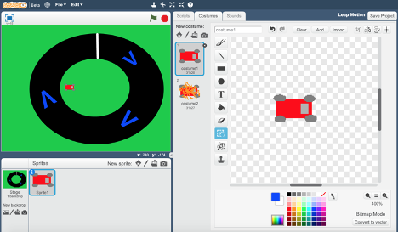
Workshop Description
Students will code their own basic racing game by following along with our visual instructions.
Step-by-step directions (with pictures) will be provided to students in a separate Word document
Notes:
Valentina: Show demo first, and then walkthrough video
Demonstration of the working game where participants can interact with our team and our game, having the chance to choose and custom their experience from various tracks we developed. Our project members will give a short description of the project to any curious event attendees, as well as to answer any other technical questions that they may have.
We will measure the results and success of the activities by administering post-activity surveys. The surveys will incorporate basic questions about the programming content, which will let us gauge the participants’ knowledge of basic programming concepts, both before and immediately after the activity.

Slide 7



Technologies
Scratch Programming Language
Scratch is a drag-and-drop programming language developed by MIT, which aims to introduce children to programming and logical problem-solving in an interactive, easily digestible manner. (Scratch, n.d.).
Scratch is designed and maintained by the Lifelong Kindergarten group at the MIT Media Lab (Scratch, n.d.).
Students will create a simple racing game using the drag-and-drop architecture of Scratch.
Leap Motion Controller
Leap motion is a computer hardware sensor device that supports hand and finger motions as inputs.
We use this technology to add functionality to the code and be able to move a car along a track by just moving your hand left and right without using the keyboard.

Slide 8
Project Files
Important Links
ScratchX
Racing Game Demo Video
Workshop Walkthrough Video
LeapForMankind_Racing_Game.sbx
Full version of racing game (open using ScratchX)
starter_code.sb2
Starter game to use during the workshop
Walkthrough-Steps.docx
Step-by-step of the steps we will be doing in today’s workshop
Notes:
Matt

Slide 9
Important Links
Google Drive Link for Project Files
https://drive.google.com/open?id=1xeHpjtpaUWBshRaEzkl8dKu9ljPkMq3a
ScratchX
http://scratchx.org/?url=http://khanning.github.io/scratch-leapmotion-extension/leapmotion_extension.js#scratch
Leap for Mankind - Racing Game Demo
https://youtu.be/UmRPOZUmWrM
Leap for Mankind - Workshop Walkthrough
https://youtu.be/heR4M5Nq6_E
Notes:
Matt

Slide 10
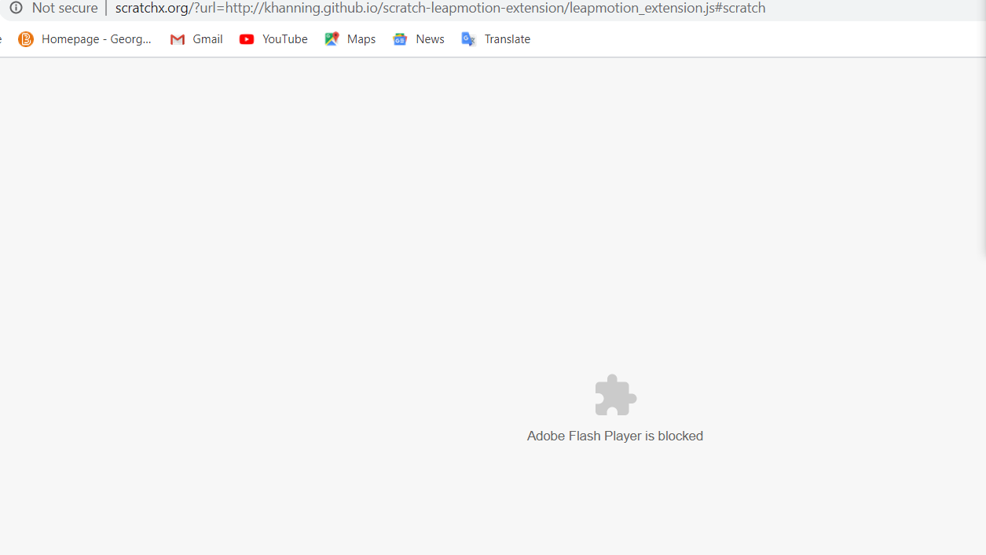
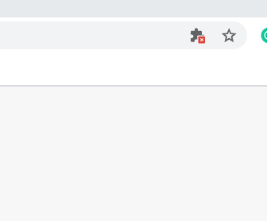
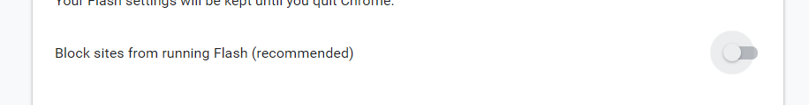
Flash Instructions
Most likely, Flash will not be automatically allowed on your browser so you will have to manually turn it on
Press the puzzle piece in the corner of the taskbar and press the blue “Manage” button
You will see a “block sites from running Flash” toggle button in gray
Press it once to change it to blue and then the toggle button will say “Ask first”
Refresh the page and click the web page to enable scratch
Notes:
Matt

Slide 11
Questions?
Please take the post-survey!
https://ggc.az1.qualtrics.com/jfe/form/SV_cuUHub5I9Vac9i5
Notes:
Ryan

